Slide 1

Sheffield Hackspace
Arduino Day 2015

Slide 2

What is Arduino?
Arduino is a tool for making computers that can sense and control more of the physical world than your desktop computer. It's an open-source physical computing platform based on a simple microcontroller board, and a development environment for writing software for the board.

Slide 3
What is a Microcontroller?
A microcontroller is a small computer on a single integrated circuit (microchip) containing a processor core, memory, and programmable input/output peripherals.
Microcontrollers are used in automatically controlled products and devices, such as automobile engine control systems, implantable medical devices, remote controls, office machines, appliances, power tools, toys and other embedded systems.

Slide 4
Why use Arduino?
There are many different type and brands of microcontrollers available to makers so why choose to use Arduino?
Inexpensive - Official boards start around £22. The open source design though allows you to build your own for just a few pounds
Cross-platform - Windows, Mac OS X and Linux
Simple programming - Easy to use environment for beginners, but flexible enough for advanced users
Huge community - Lots of support and literature for learning, as well as thousands of libraries to make programming simple
Open source - Hardware and software

Slide 5
The Arduino Uno
The main prototyping platform for Arduino is the Arduino Uno board. It is small, cheap, easy to program and has a reasonable amount of I/O
Input Voltage 7v-12v
Digital I/O Pins 14
PWM Pins 6
Analog In Pins 6
Flash Memory 32kb

Slide 6
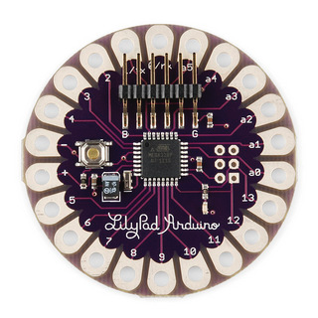
Other Arduino Boards
Other boards with more I/O, smaller form factor, different voltages, etc - even a robot! - are available to suit your project.

Slide 7
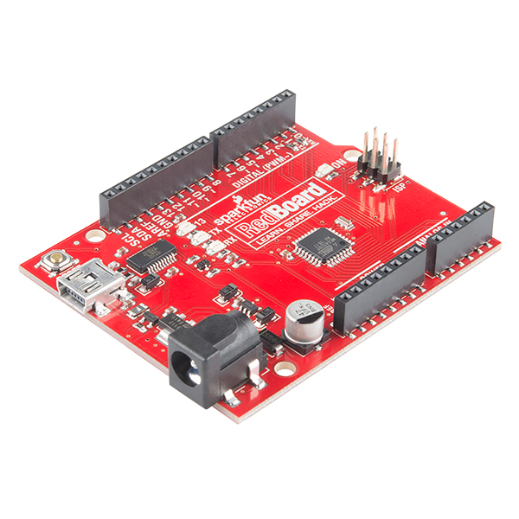
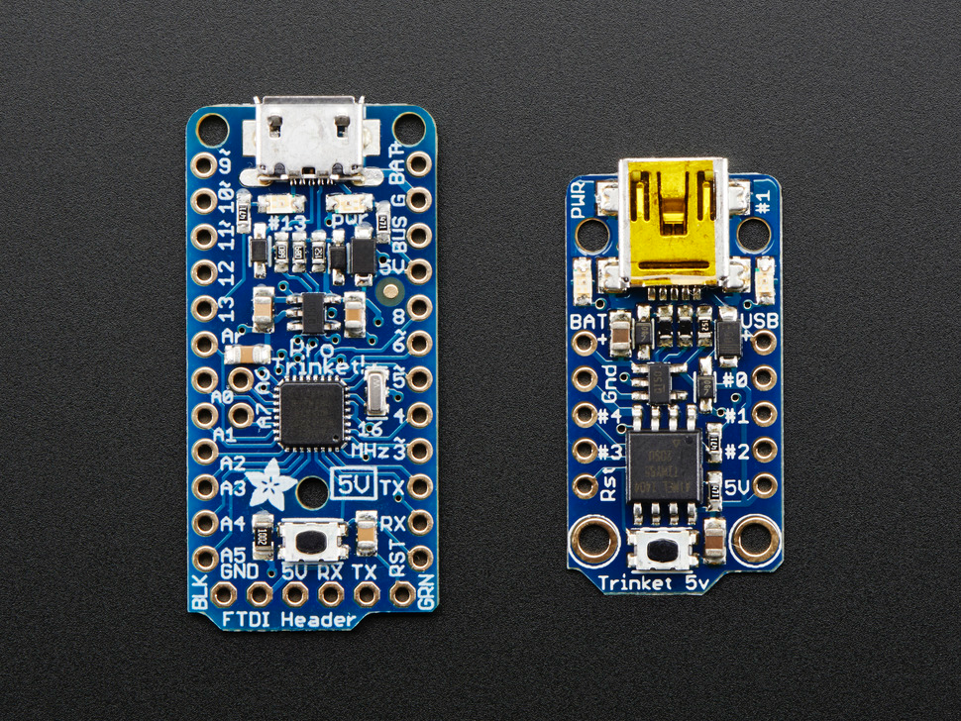
Arduino Compatible Boards
As Arduino is an open source project other manufacturers have created their own boards which can be programmed with the Arduino IDE.
Examples of these include the RedBoard by Sparkfun, the Trinket, Pro Trinket and Flora by Adafruit and the Teensy by PJRC

